Slide 1

EXAM SEATING ARRANGEMENT SYSTEM GitHub Link: https://github.com/Lakshmikala77/EXAM-SEATING.git
Batch No: A-02 Project Guide:
LAKSHMI KALA C (174G1A0530) Mr.M.NARASIMHULU,M.Tech.
GOVARDHAN D (174G1A0519) Assistant Professor
BHARATHI N (174G1A0513)
ASWINI S (174G1A0512)
Srinivasa Ramanujan Institute of Technology
Department of Computer Science & Engineering

Slide 2
Contents
Introduction
Existing System
Proposed System
Abstract
Problem definition
Design Modules
Outputs
Conclusion
References

Slide 3
Introduction
In every engineering institutes held the examinations at a regular interval of time. Allocating the students to different blocks according to their strength is the main job .But manually allocating of students is a hectic job for the staff. So to remove this disadvantage this project is designed to eliminate the manual work of the staff. We are going to design an web portal.

Slide 4
Existing System…
In the existing system the exams are done only manually. There is a lot of manual work involved in current system and also more energy is wasted to allocate the seating arrangement.
LIMITATIONS:
Time consuming
Less Efficient
More manual work required
Less accurate

Slide 5
Proposed System…
The aim of proposed system is to develop a system of improved facilities. It can overcome all the limitations of the existing system.
Storing and retrieving of information is simple. So work can be done correct time and also good in speed.
User friendliness and interactive.
Minimum time required.

Slide 6
Abstract
In an Institute, specifying the classroom with seat position is the work carried out during exams conducted by the university. Most of the work carried out through office software and printouts attached on the surroundings of the institute boards. The process of arranging students into the available classrooms is a tedious process. In this process, one or more anomalies occurred as if student can able to reflect in one or more classrooms or it cannot allotted at all. This can happen when number of students and number of classrooms are more.

Slide 7
Problem definition
PROBLEM:
Presently, the seating arrangement for the examinations is done manually. Initially the examination section has to collect all student examination registration details branch wise and year wise. These details include name, roll no, branch, year, list of subjects registered for exam. The administrator need to count the total number students registered. Then the administrator needs to select the rooms and divide the students among those rooms. After dividing the rooms he need to prepare students list for each based on the exam.

Slide 8
Continued…
SOLUTION:
EXAMINATION HALL SEATING ARRANGEMENT APPLICATION is developed for the college to simplify the allocation of halls to students during exams. It facilitates to access the examination information of a particular student in a particular department. This system generates seating arrangement and student list for each room.

Slide 9
Design
Modules
Admin Login Module
Student Data entry Module
Faculty Module
Exam seating arrangement module
Display module
Print Module

Slide 10
Module Description
Admin Login Module:
Here admin has to login by using their unique username and password. Admin is the only authorized person to access.
Student Data entry Module:
In this, the admin can add the students data .
Faculty Data Module:
In this, the admin can allocate the class room for invigilators.
Exam Seating Arrangement Module:
In this, the admin can allocate the rooms for the students.
Display Module:
In this , the admin can see the updated data.
Print Module:
In this, the admin can print the updated data.

Slide 11
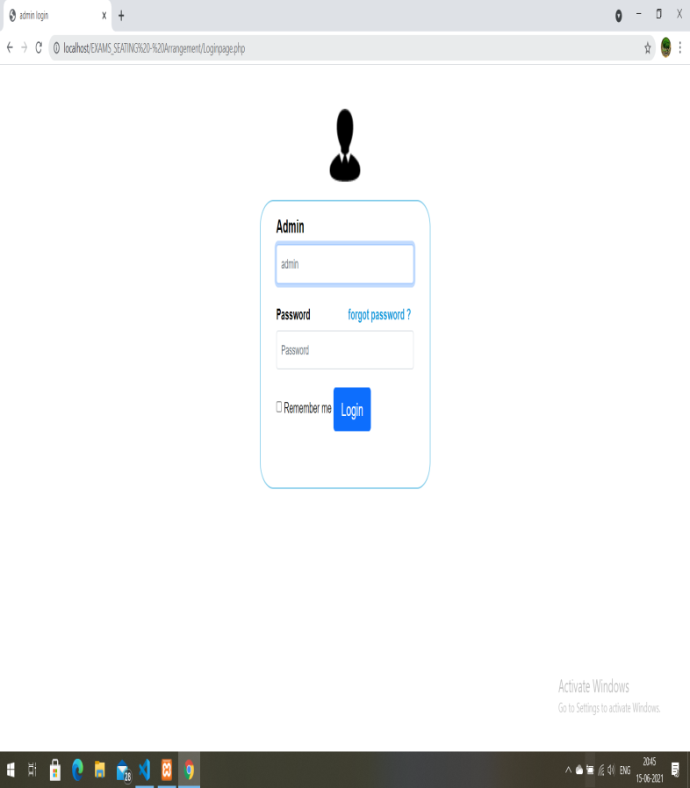
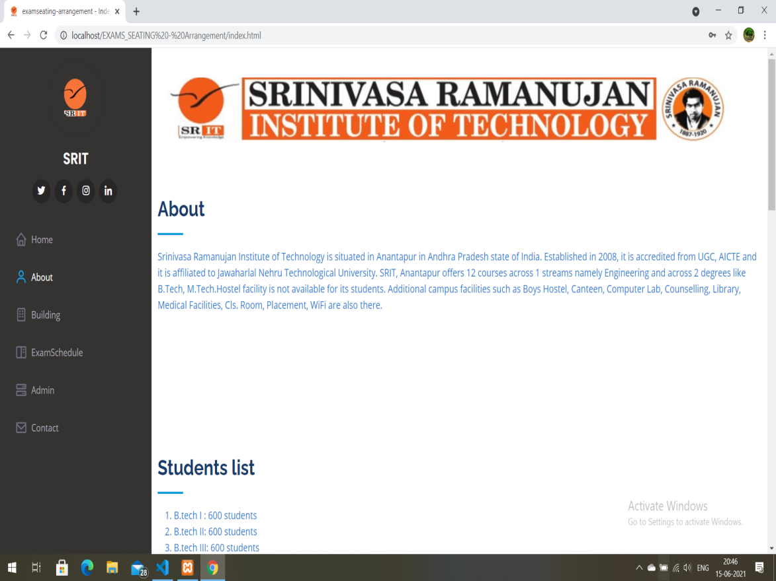
Outputs Admin login Home page

Slide 12
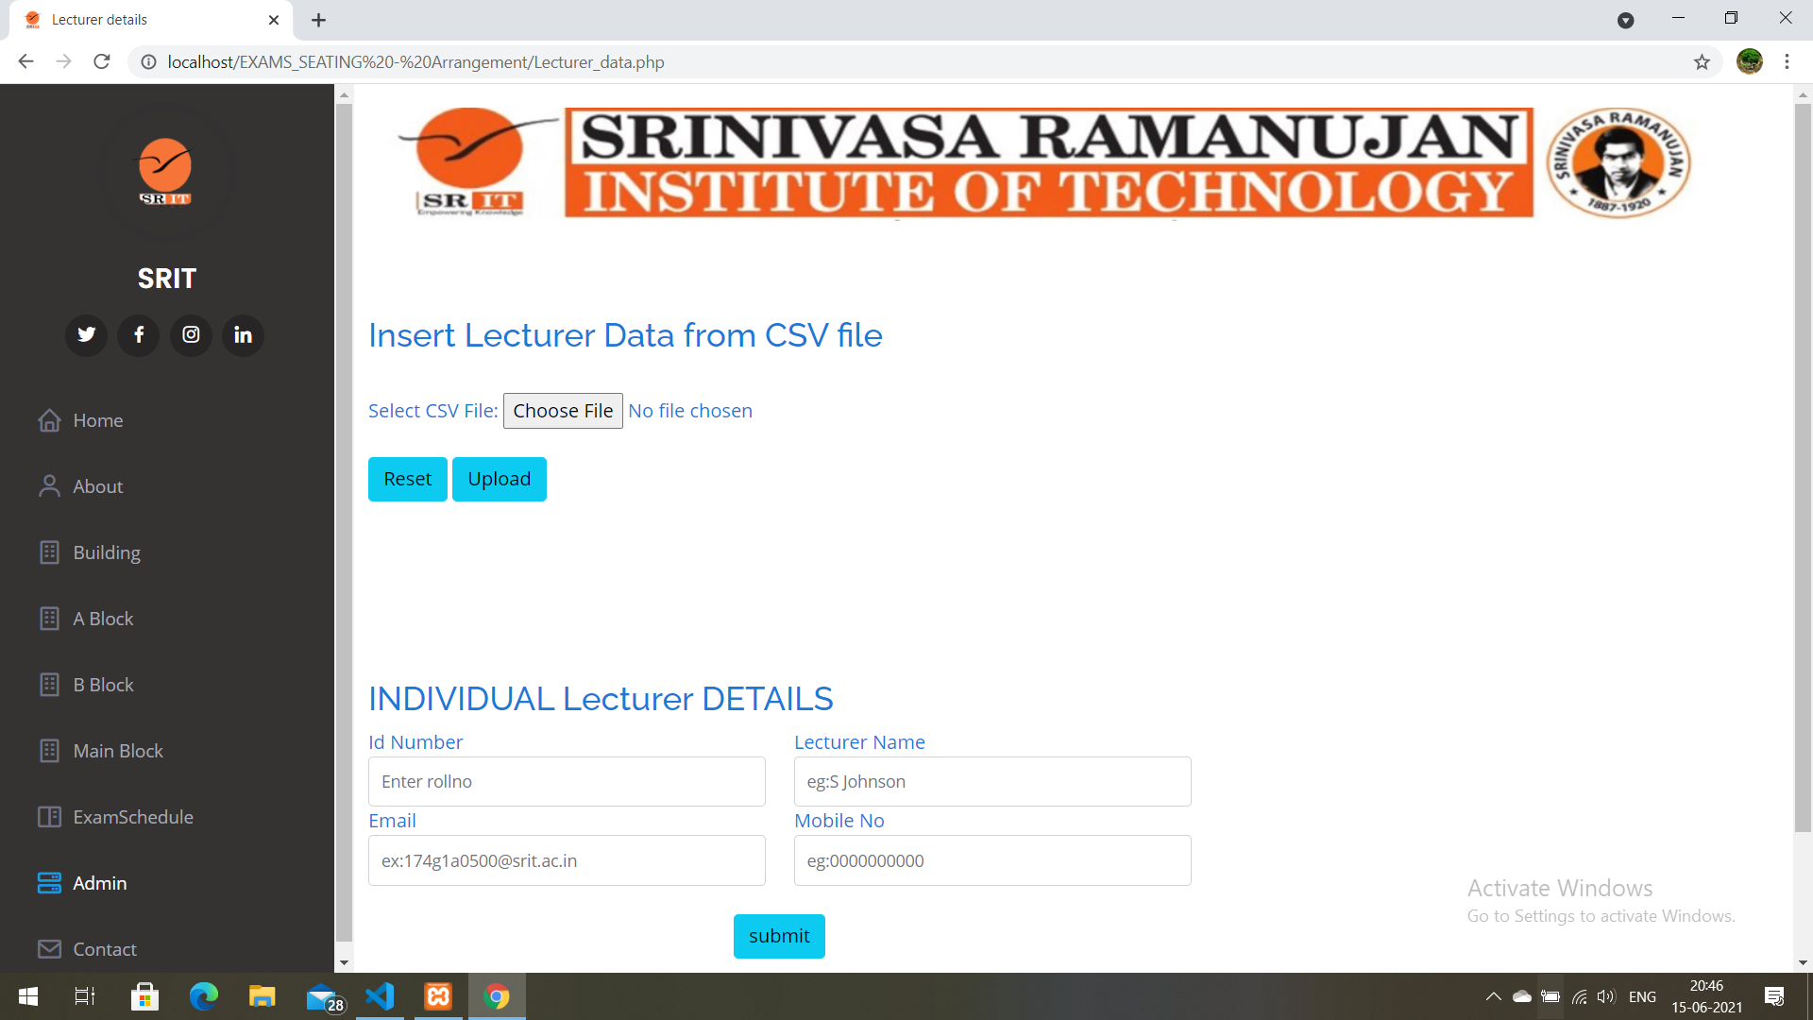

Student data Insertion Lecturer data insertion

Slide 13
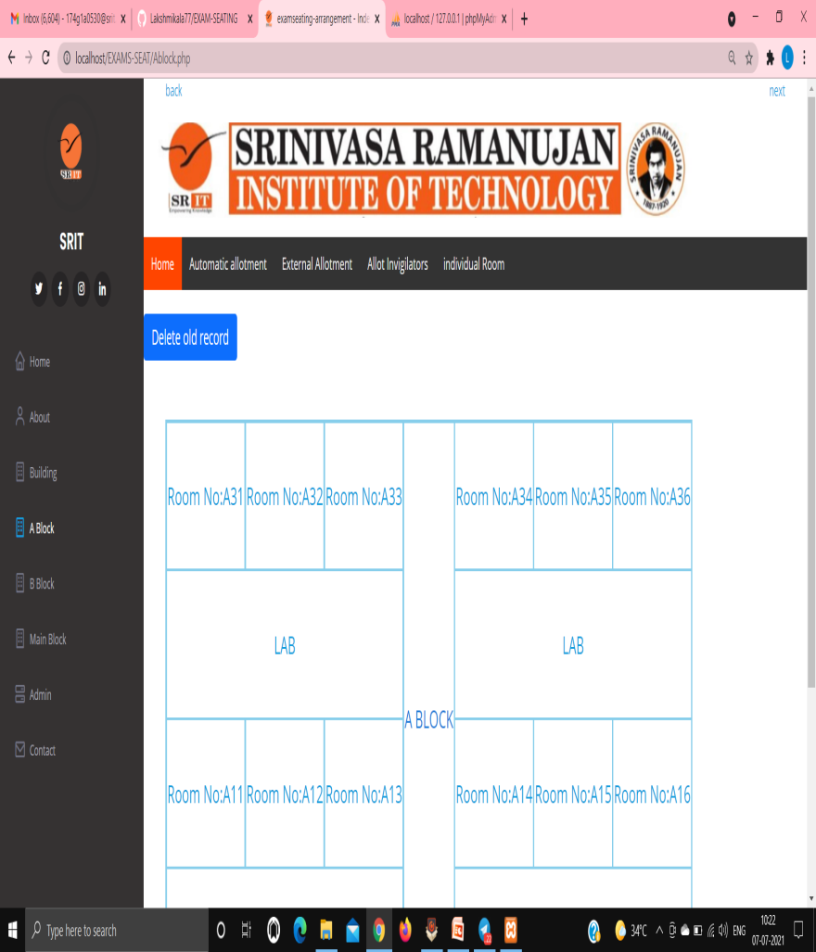
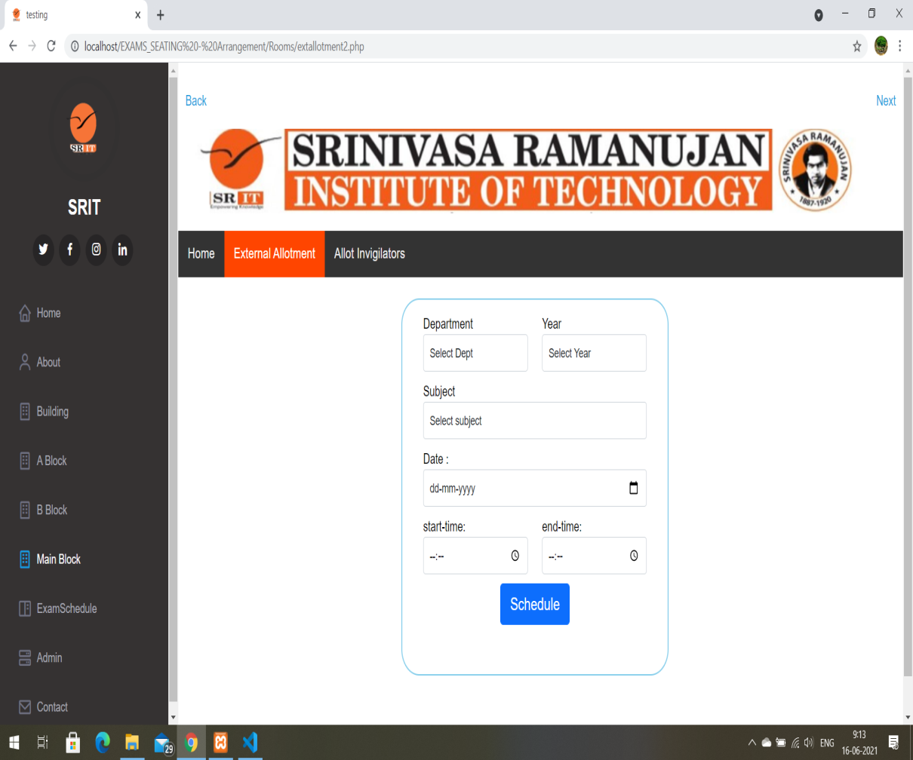
Home page of Block Automatic allocation

Slide 14
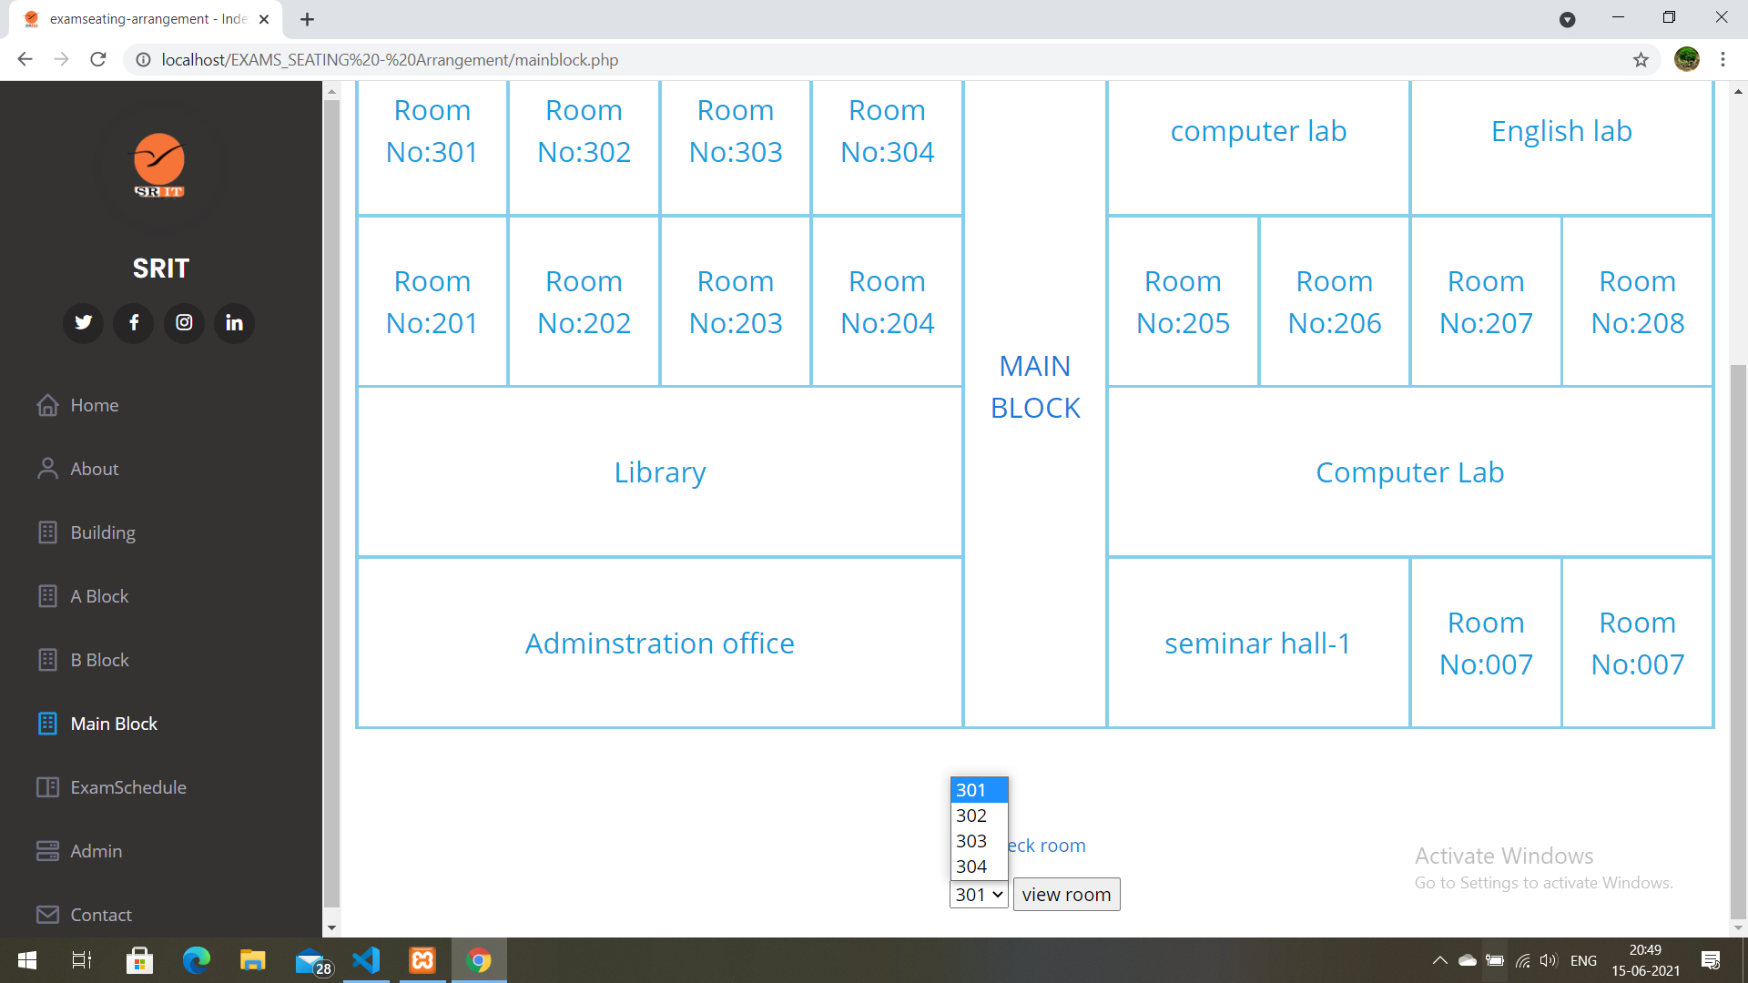
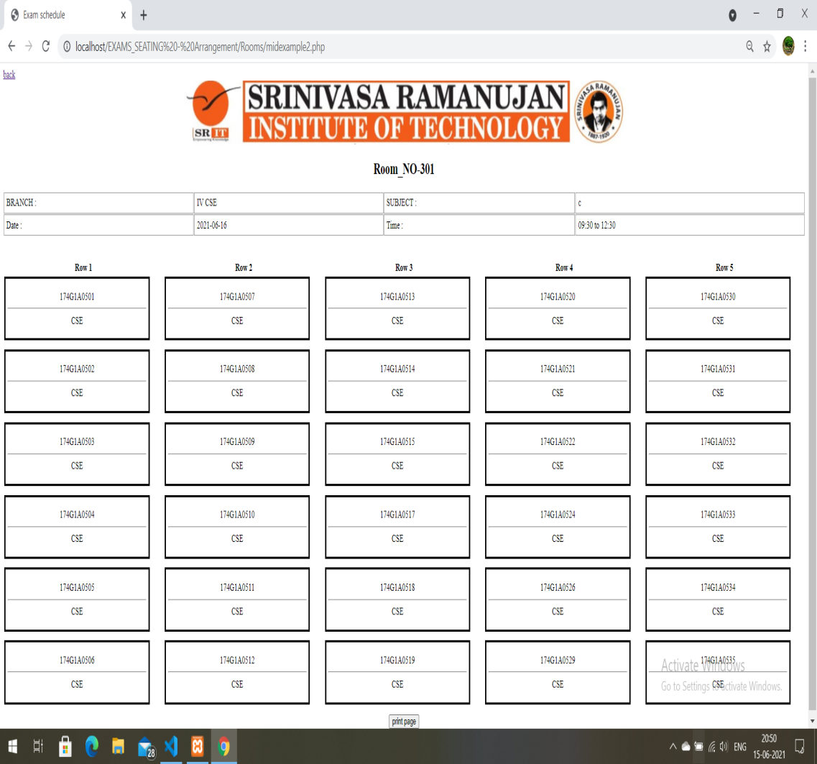
Viewing the allocated rooms

Slide 15
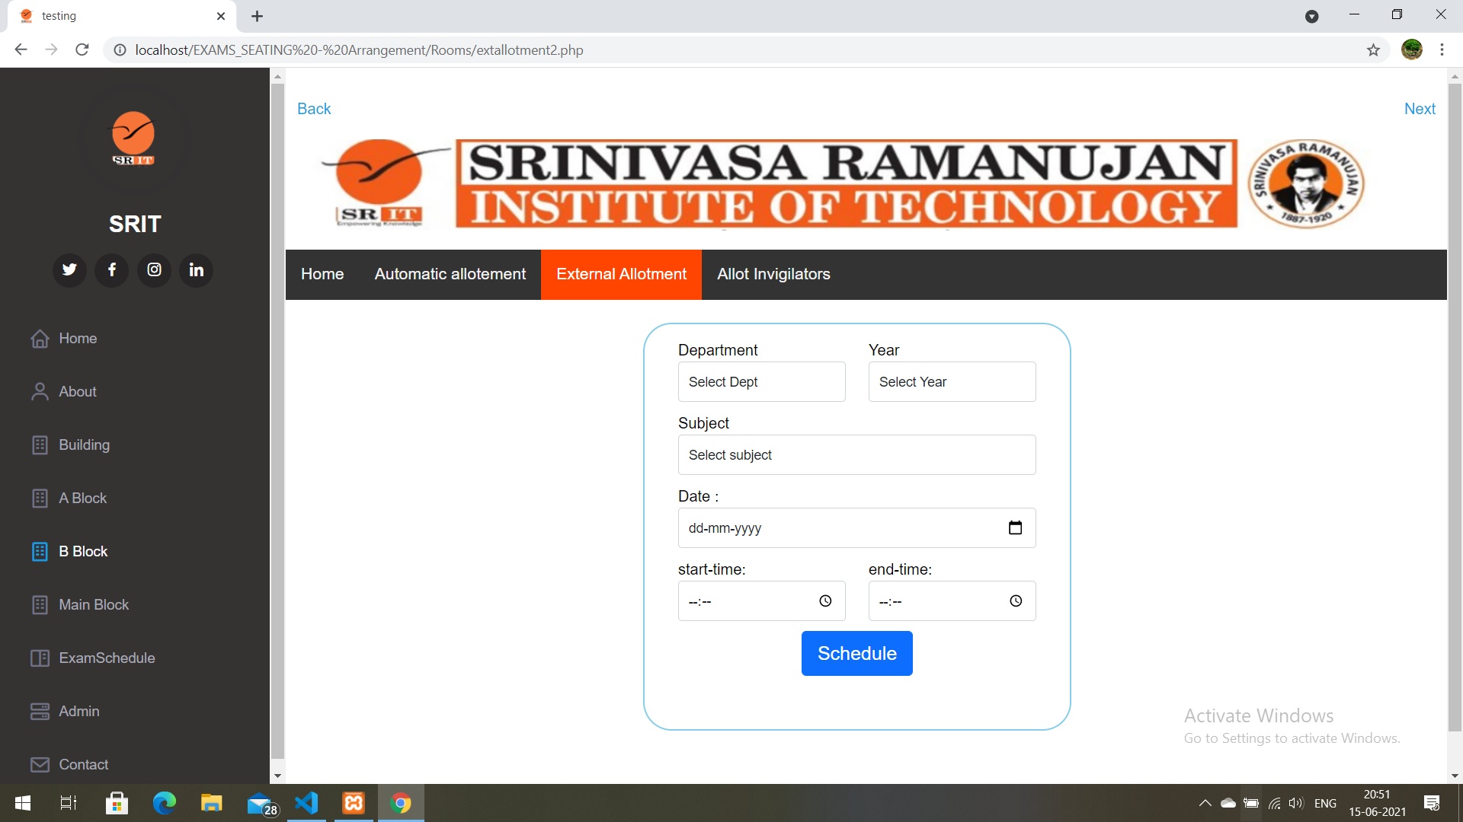
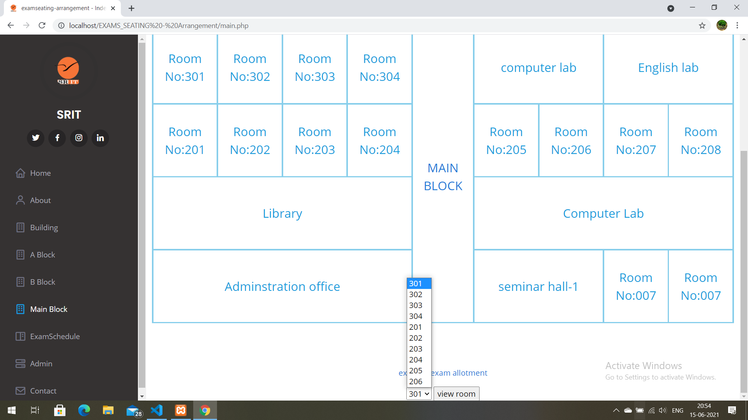
Allocation for external exams

Slide 16
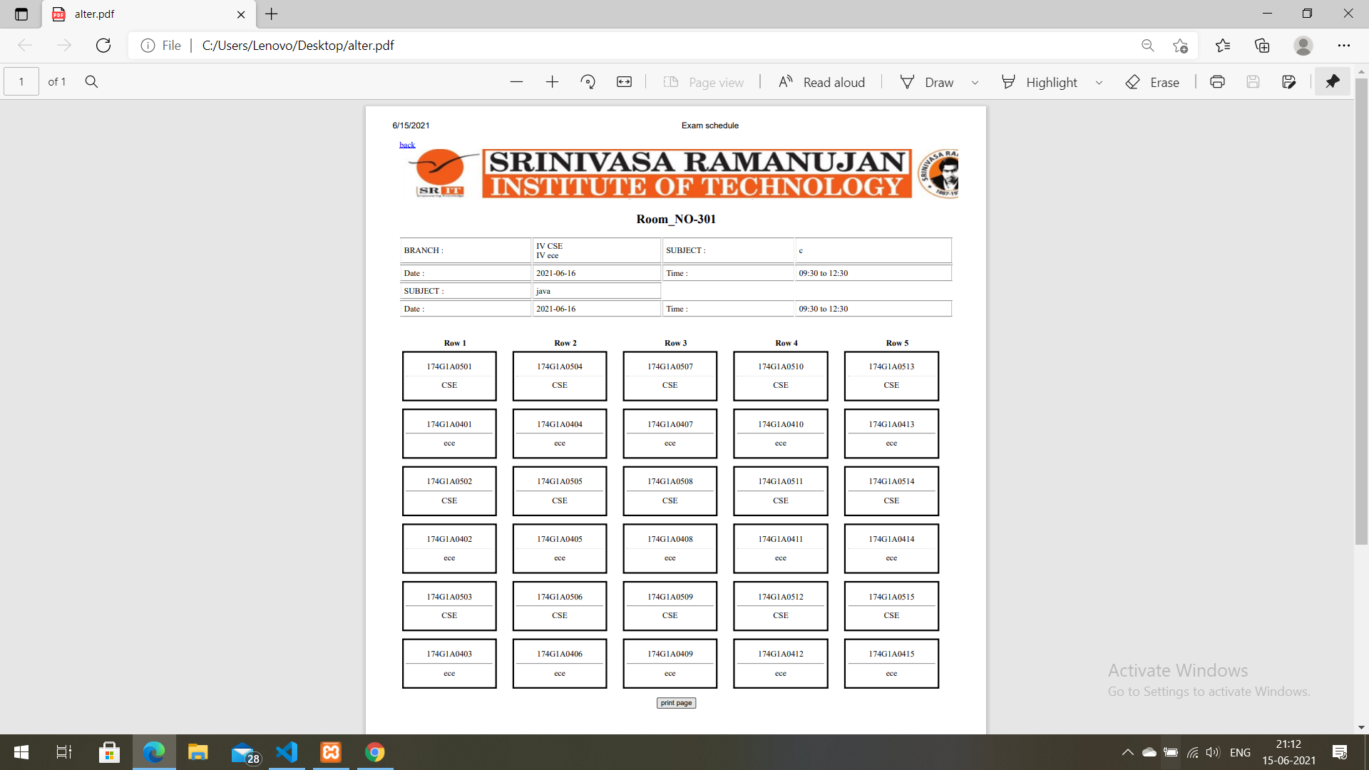
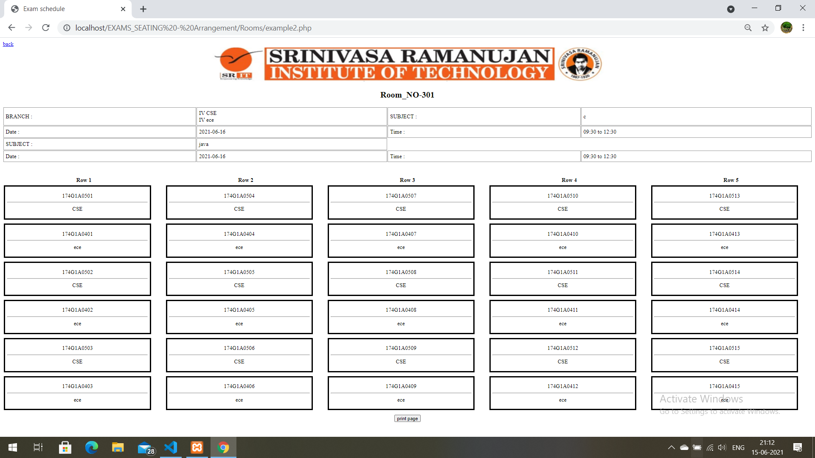
Displaying the allocated data

Slide 17
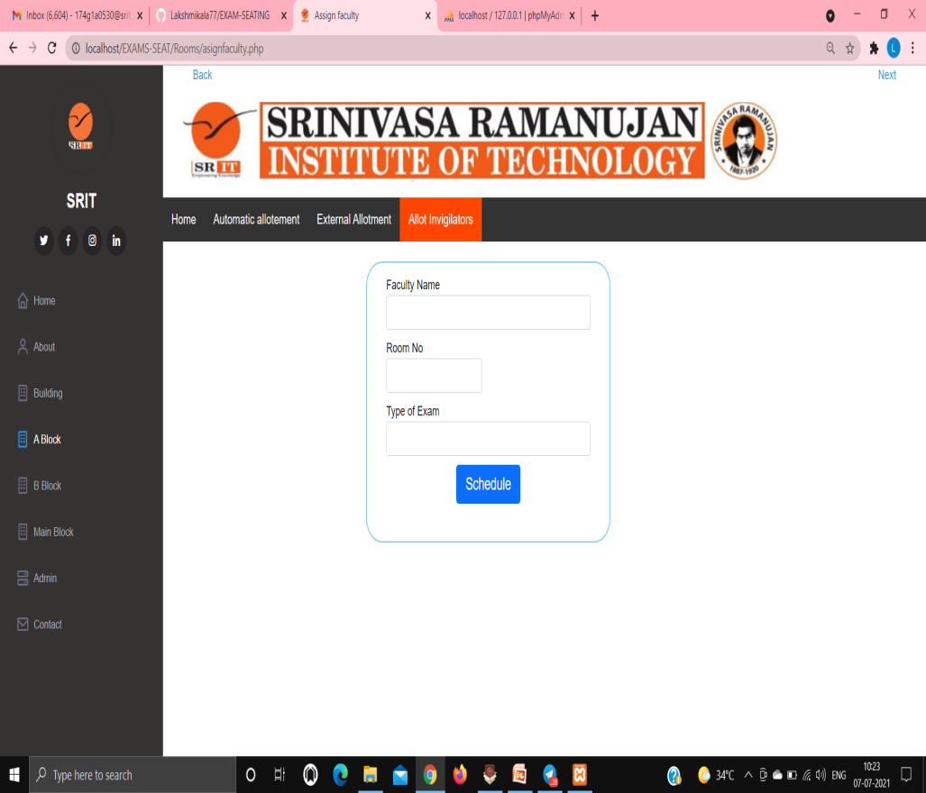
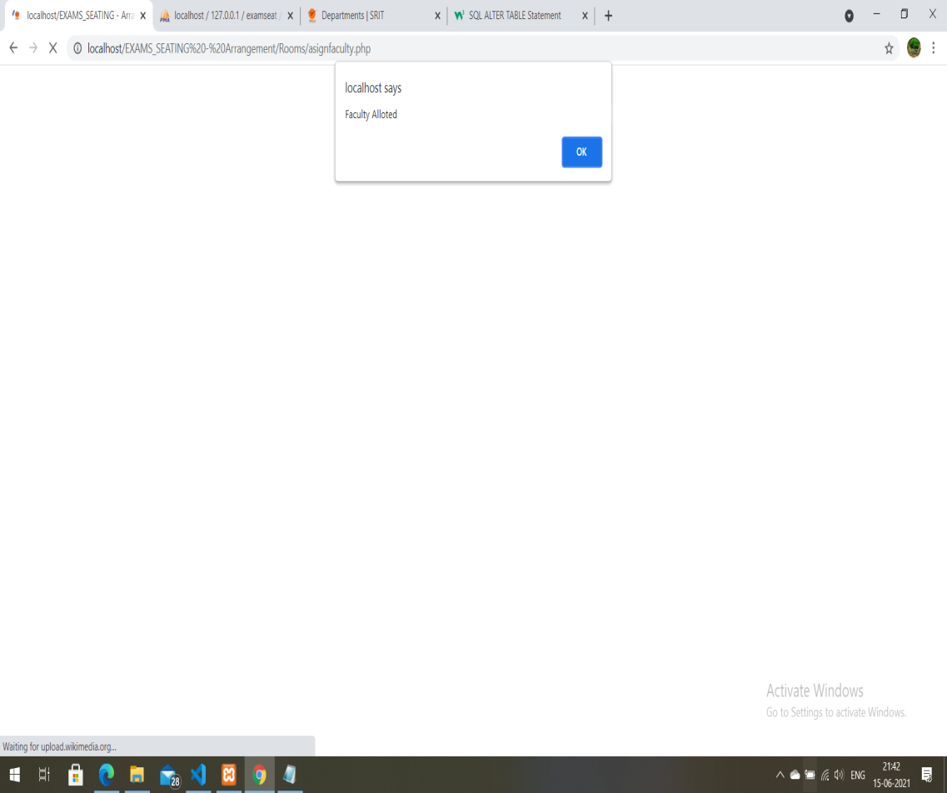
Faculty Allotment

Slide 18
Conclusion
This system avoids the manual work and the problems concern with it. The system was designed in such a way that future modifications can be done easily.
The following conclusions can be deduced from the development of the project. It provides a friendly user interface. The system has scope for modification in future if it is necessary.

Slide 19
References
[1] “Exam hall seating arrangement system using php”, International Journal of Innovative Research in Technology, vol. 1, no. 11, 2014.
[2] Exam hall seating arrangement System using PHP, Author-Prof S.S.Aravinth,G.Pavithra,
link- http://www.ijirt.org/vol1/paperpublished/IJIRT101629_Paper.pdf
[3] https://www.w3schools.com/pHp/default.asp
[4] https://www.guru99.com/php-tutorials.html

Slide 20
Thank you
Queries
?

